Slide 1
HIV (human immunodeficiency virus)
Mohammad Bayat
Joanne Pyo
Akil Bhuiyan

Slide 2
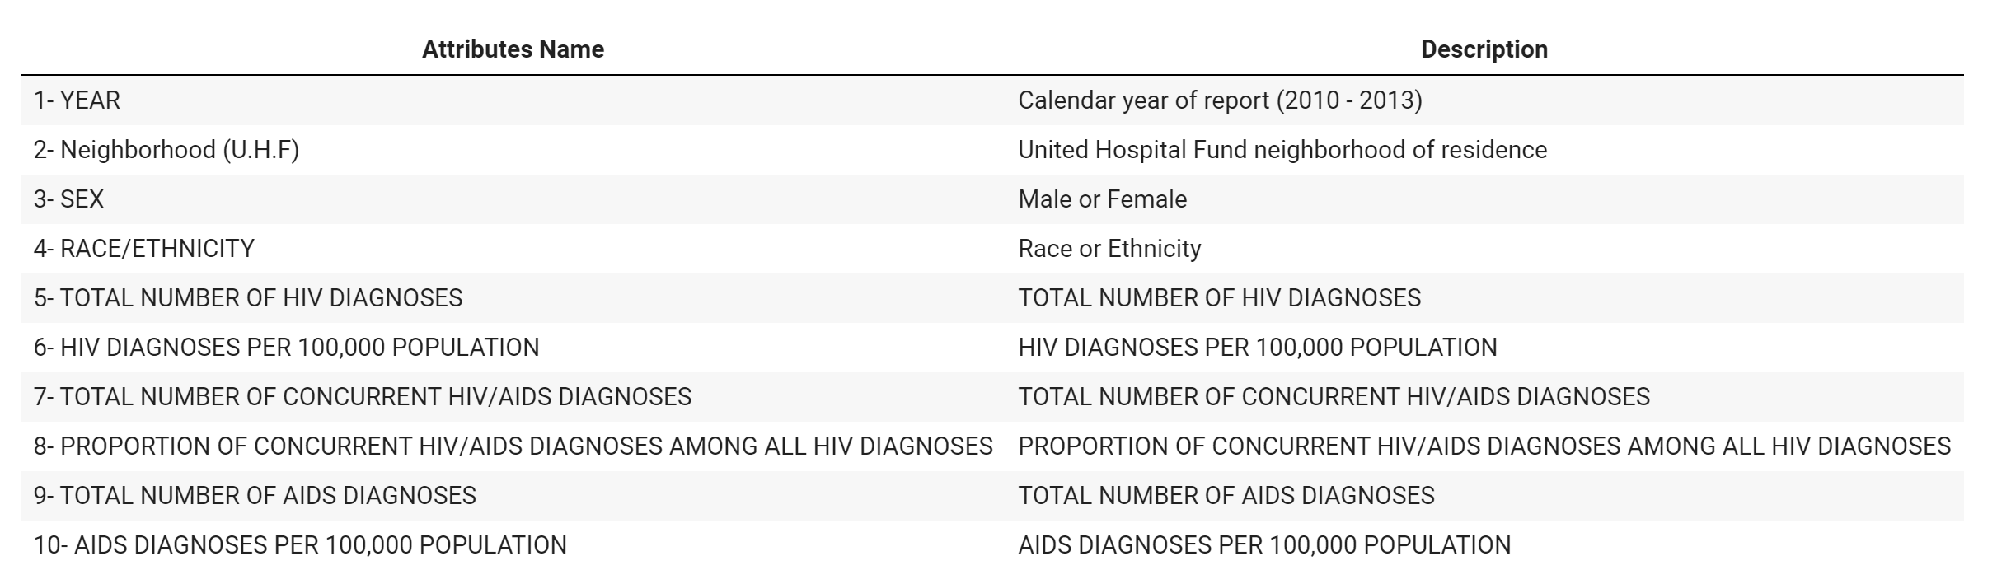
Proposal
Data Summary
Some facts about HIV in the USA are HIV/AIDS is a big problem in our country and HIV is not the same as AIDS, HIV tests are reliable and HIV can not be cured. It is very unfortunate that about 13% of people living with HIV in the US do not know they are infected. AIDS is the most serious stage of HIV, and it leads to death over time. Without treatment, it usually takes about 10 years for someone with HIV to develop AIDS. Treatment slows down the damage the virus causes and can help people stay healthy for several decades.
For the project we used NYC OpenData where we have around 3000 rows with 10 attributes.
Data Sets:
Our Data Set represents HIV/AIDS Diagnoses by Neighborhood, Sex, and Race/Ethnicity. This dataset includes data on new diagnoses of HIV and AIDS in NYC for the calendar years 2010 through 2013. Reported cases and case rates (per 100,000 population) are stratified by age group, race/ethnicity, and United Hospital Fund (UHF) neighborhood. The study in our dataset was conducted on both males and females and returns the total number of diagnoses and shows the impact based on the location and the ethnicity. Rates marked "NA" cannot be calculated because the underlying population size is unknown. Tables or charts may contain suppressed data: cells representing 1-5 person(s) with an underlying denominator of < 500 persons, or non-zero cells with a denominator <= 100 as per Intercensal 2014 estimates, are marked with an asterisk (*). In our dataset, we have 2928 rows and 10 attributes with integer, float, and object datatypes.

Slide 3
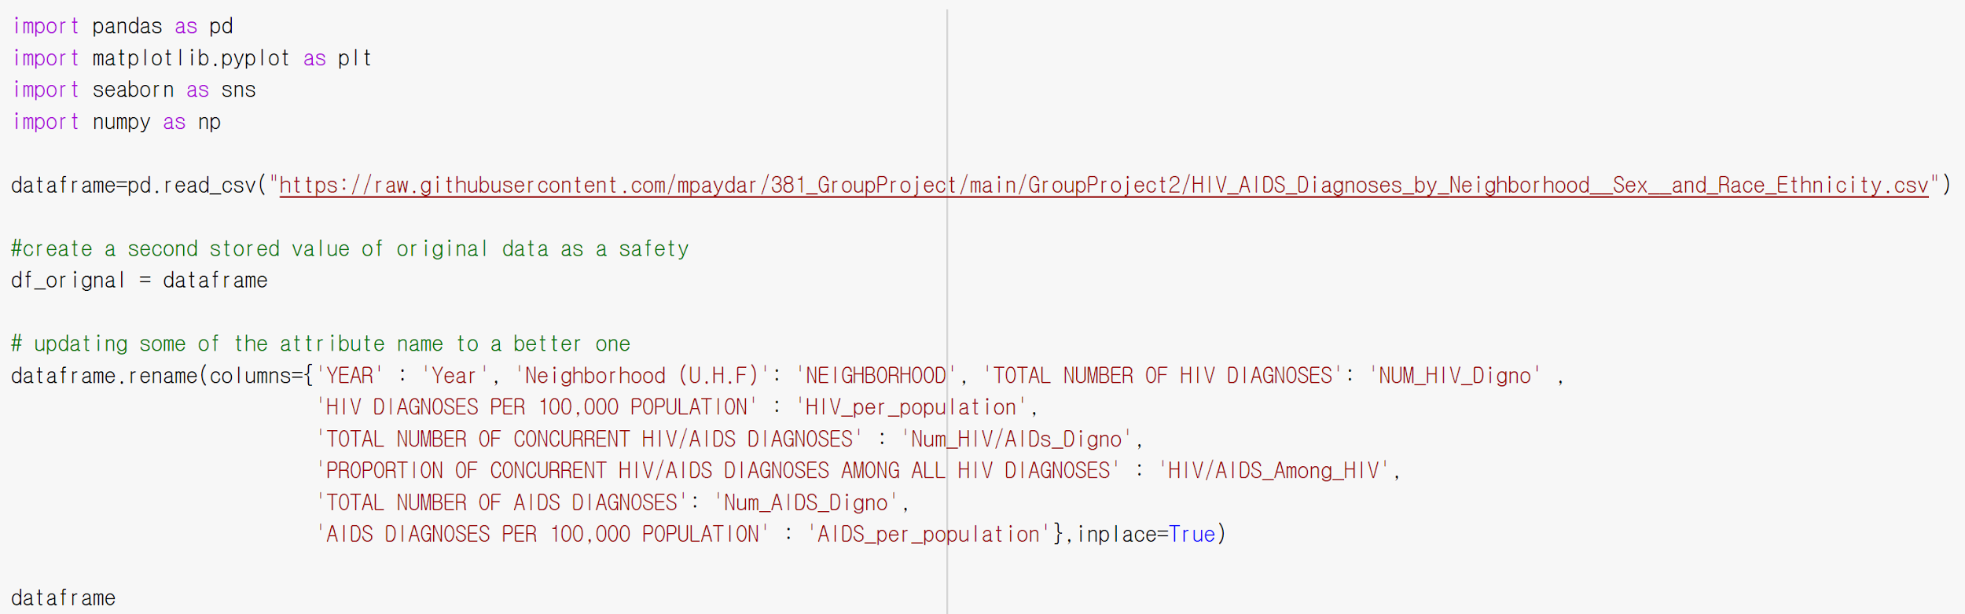
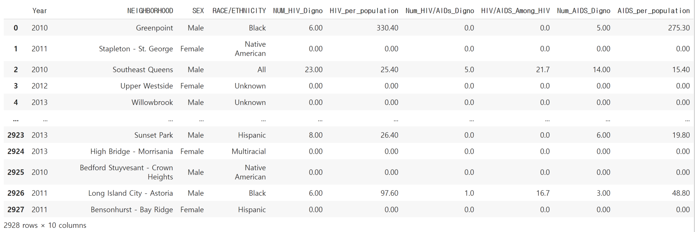
Initial Exploratory Data Analysis

Slide 4
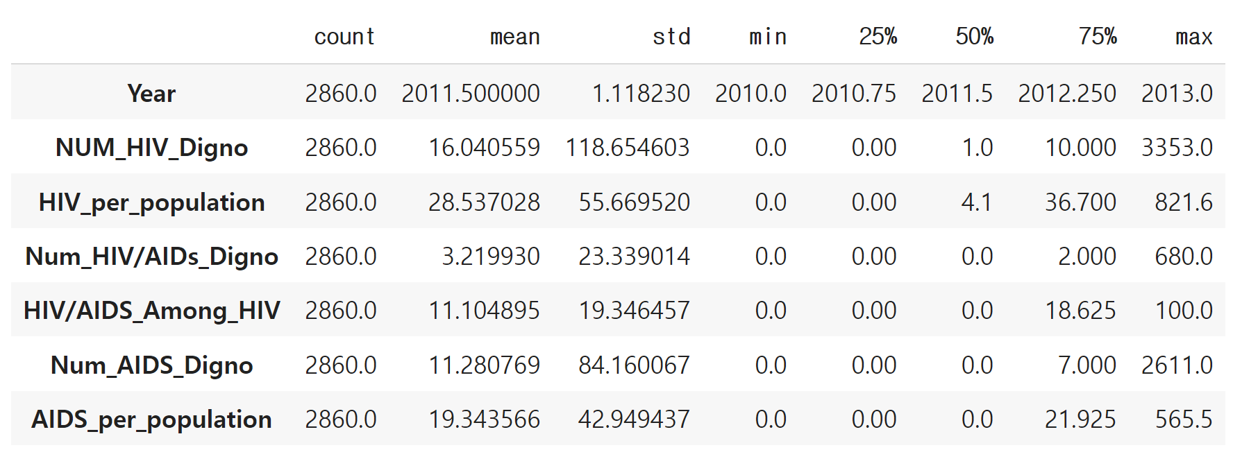
Data Describe

Slide 5
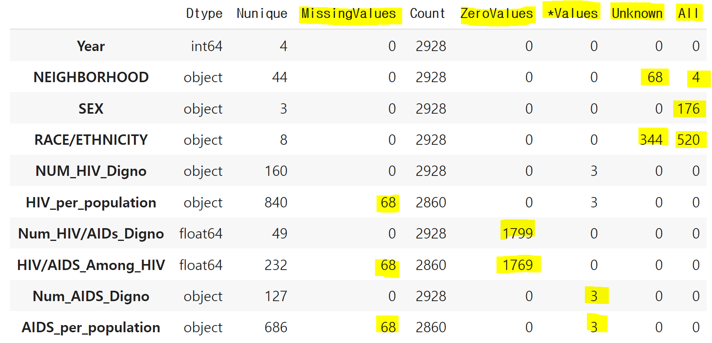
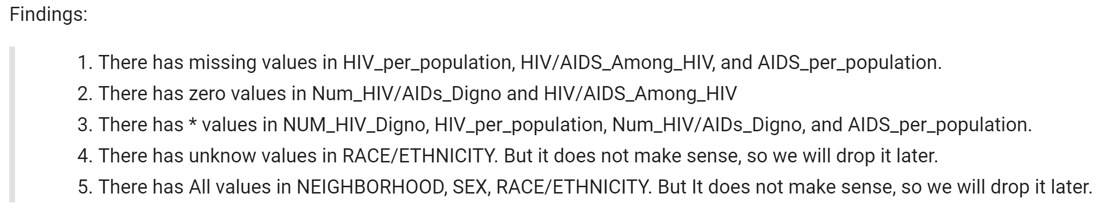
Check the data types, unique values, missing values, count, zero values, and * values.

Slide 6
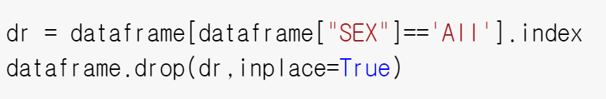
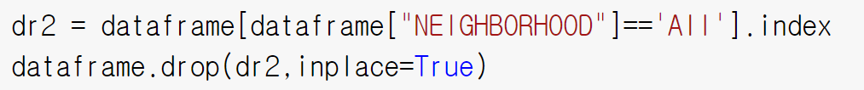
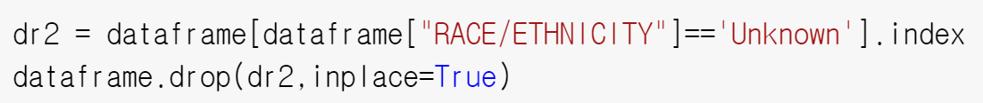
Drop it some unnecessary datas.

Slide 7
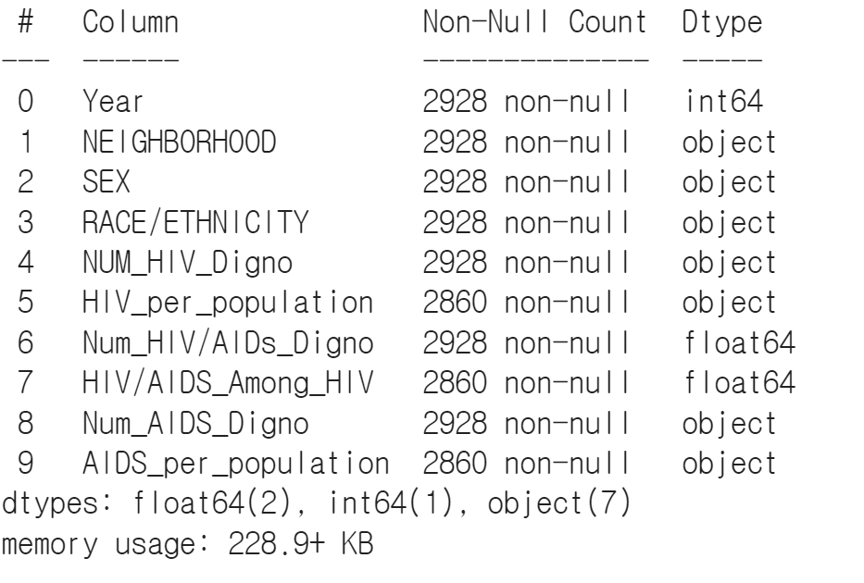
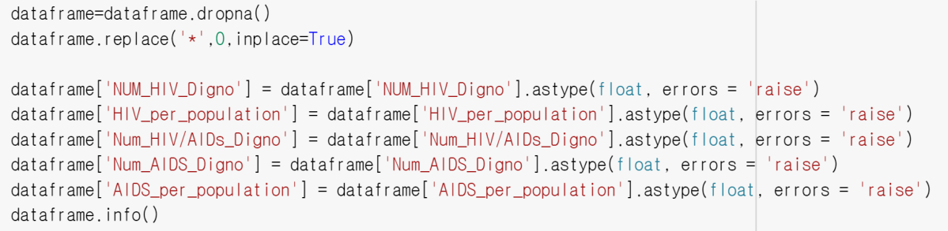
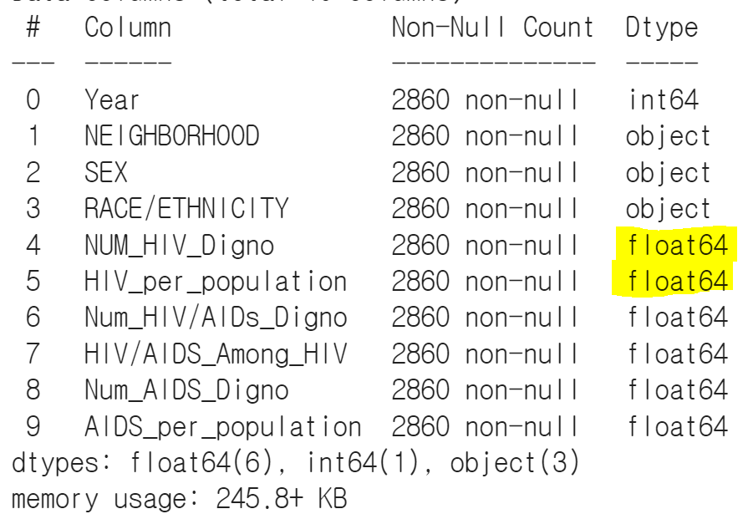
Change object Dytpe to float Dtype

Slide 8
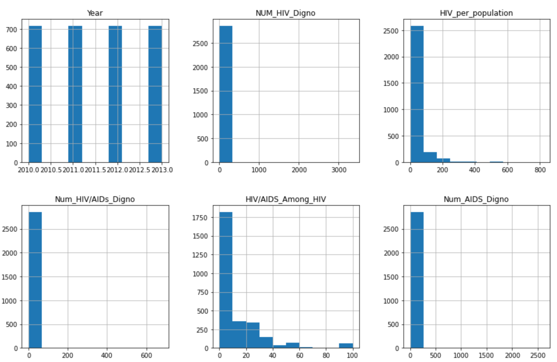
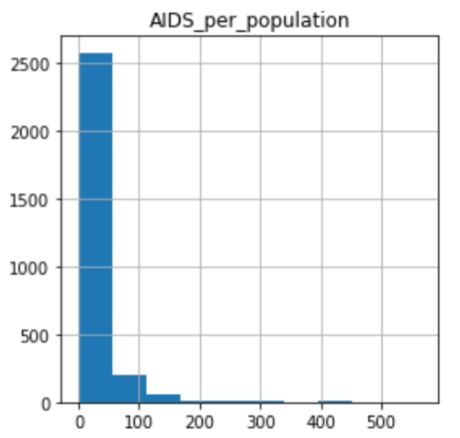
Histogram

Slide 9
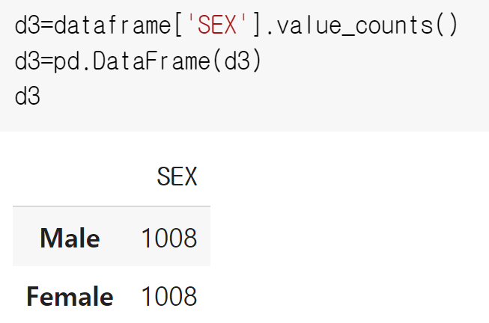
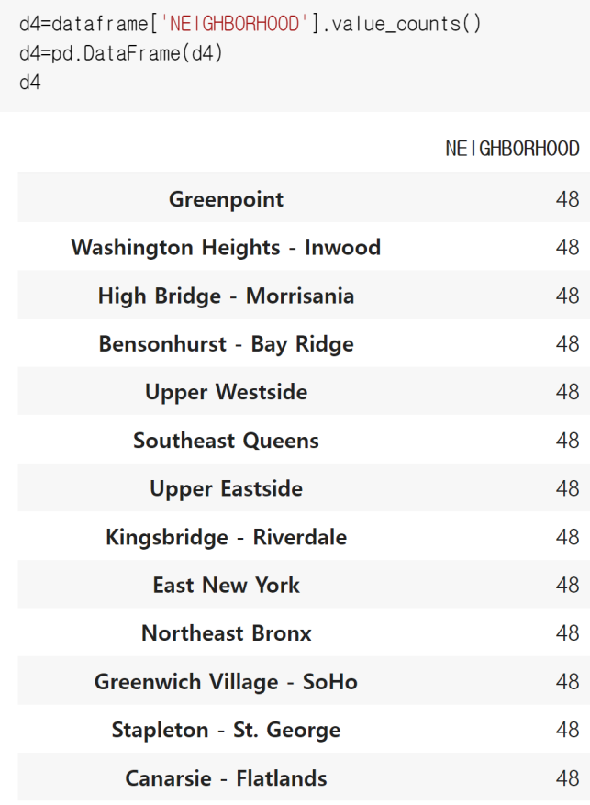
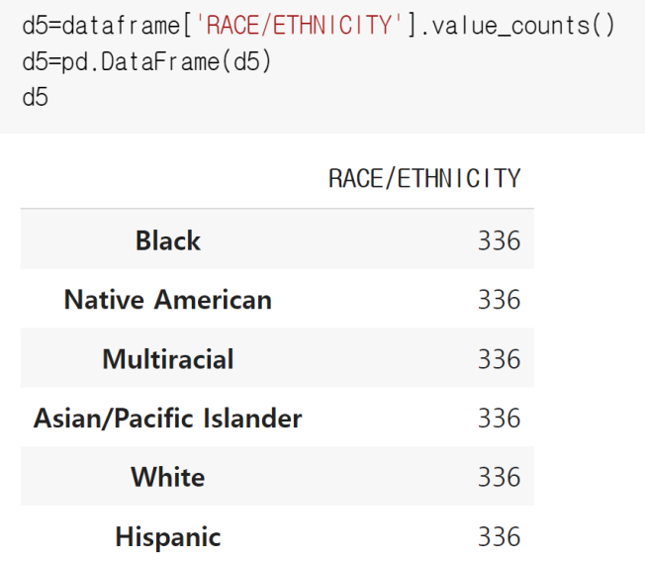
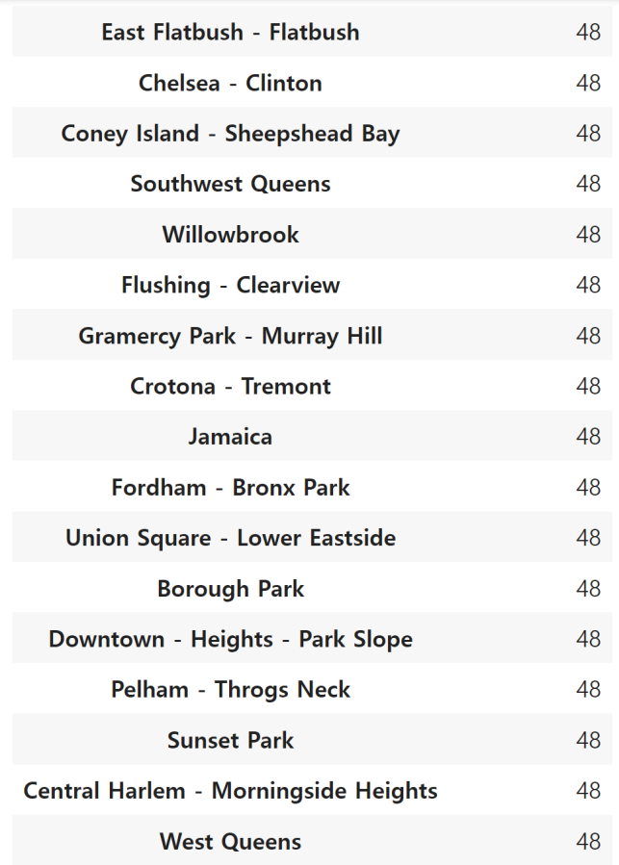
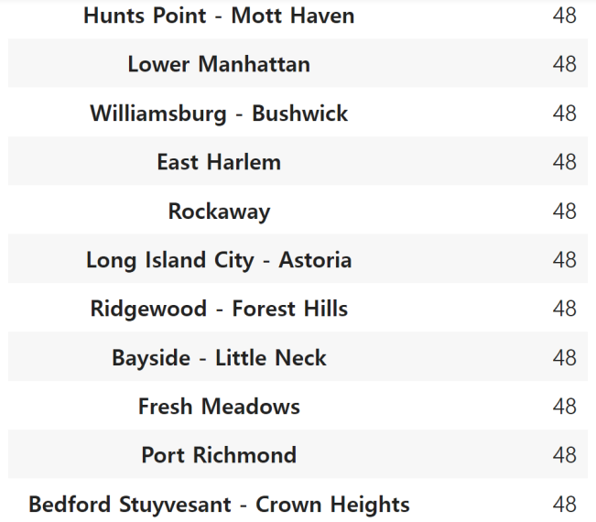

Slide 10
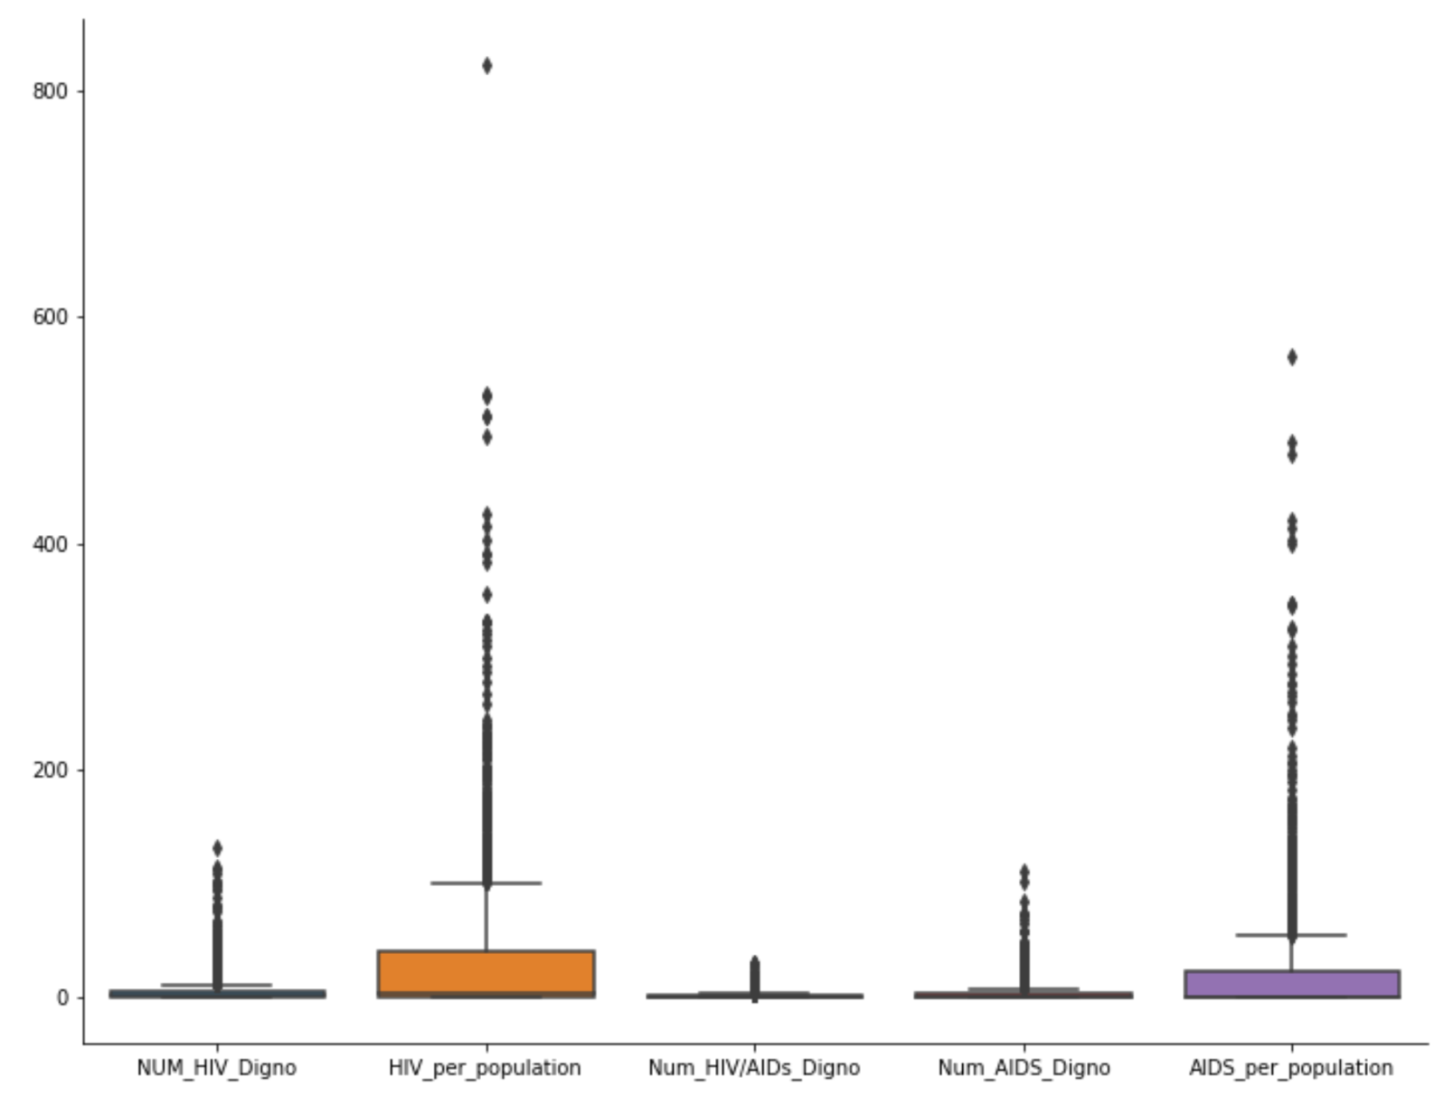
Boxplot

Slide 11
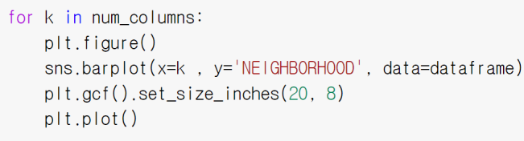
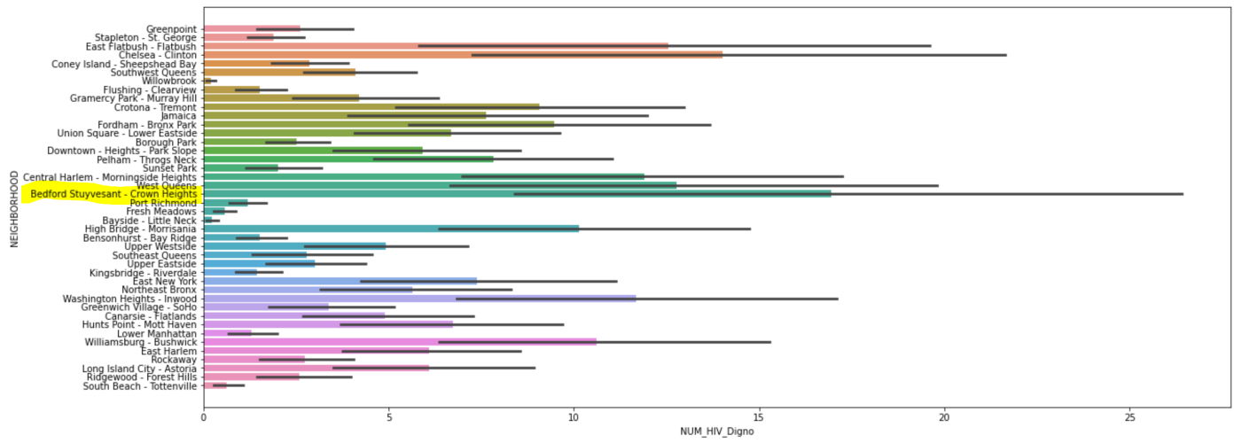
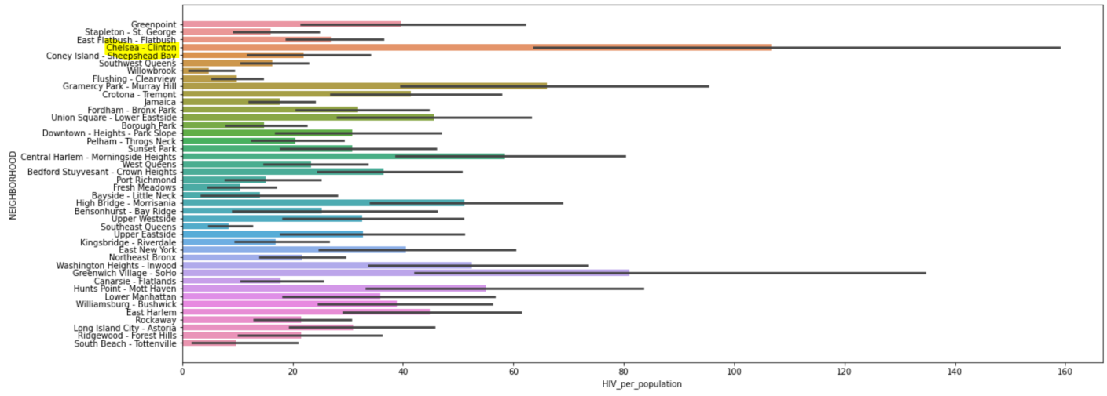
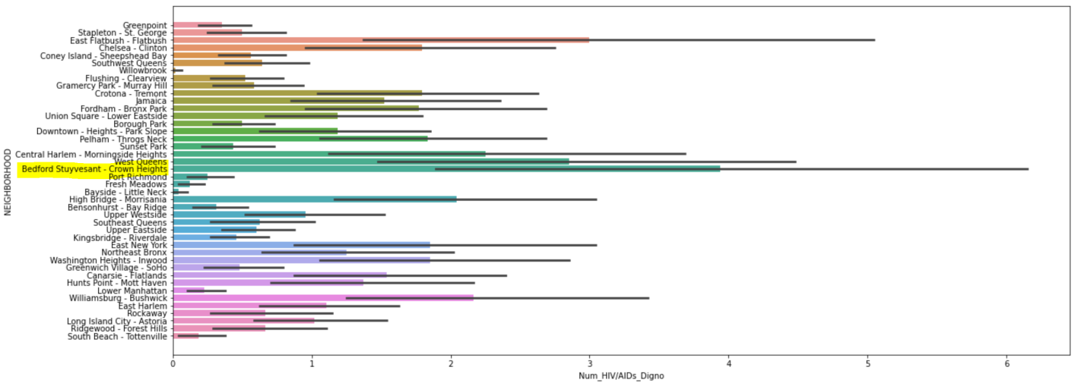
1. NEIGHBORHOOD X NUM_HIV_DIAGNO = Bedford Stuyvesant-Crown Heights.
2. NEIGHBORHOOD X HIV_per_population = Chelsea-Clinton.
3. NEIGHBORHOOD X Num_HIV/AIDs_Digno = Bedford Stuyvesant-Crown Heights.

Slide 12
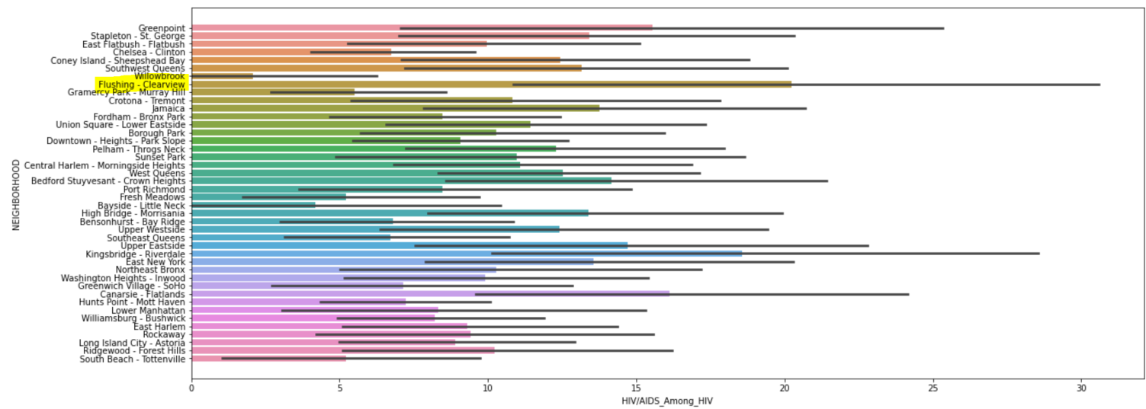
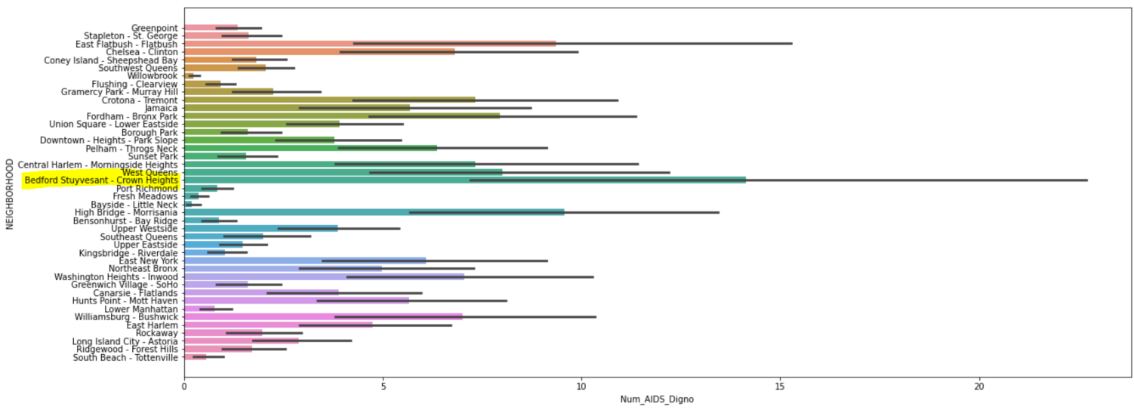
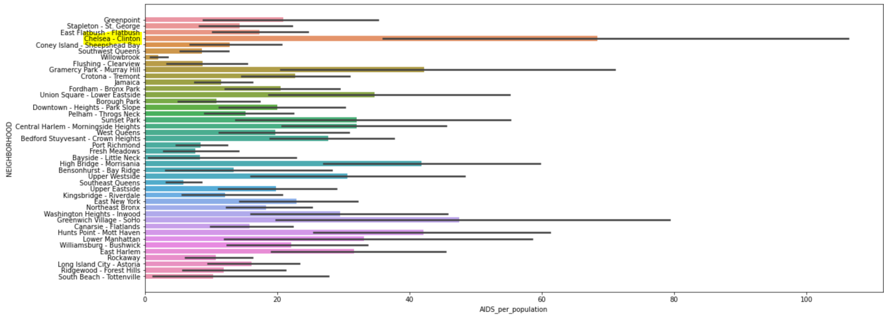
4. NEIGHBORHOOD X HIV/AIDs_Among_HIV = Flushing-Clearview
5. NEIGHBORHOOD X Num_AIDS_Digno = Bedford Stuyvesant-Crown Heights.
6. NEIGHBORHOOD X AID_per_population = Chelsea-Clinton.

Slide 13
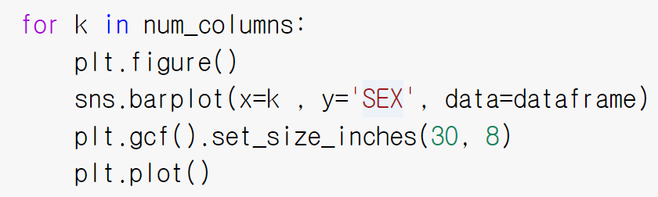
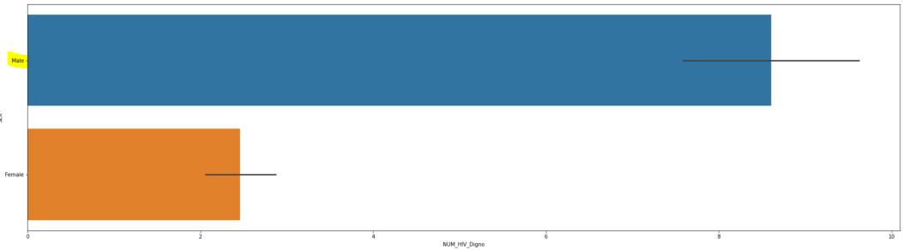
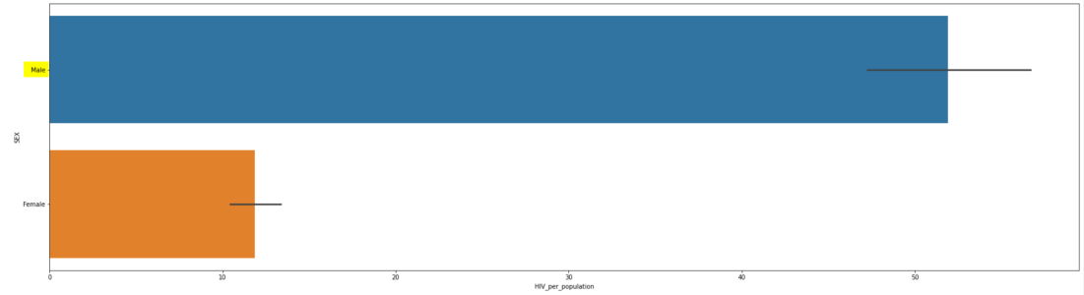
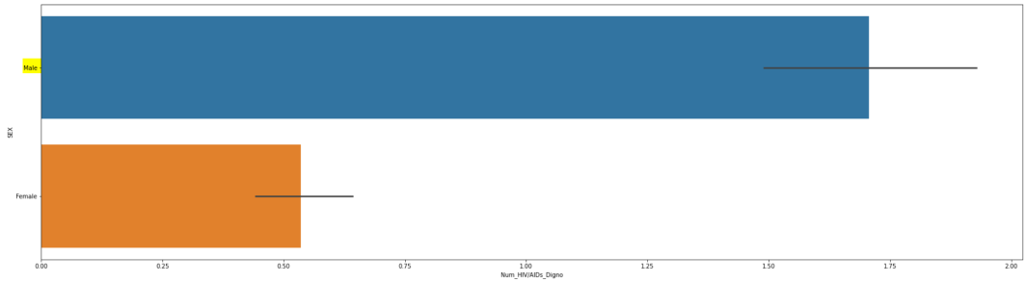
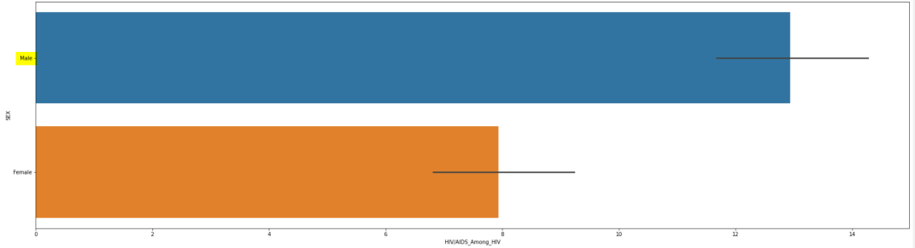
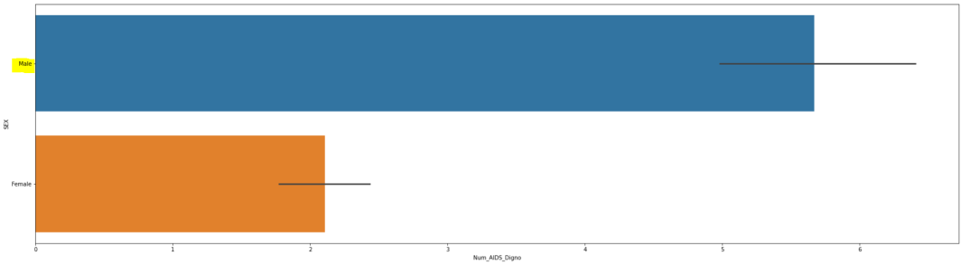
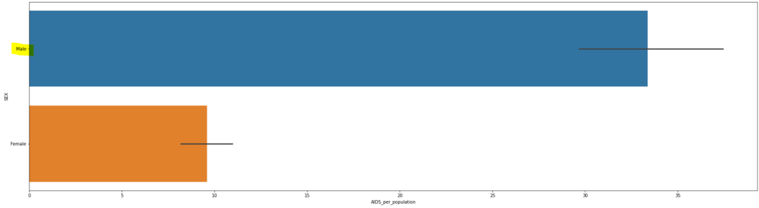
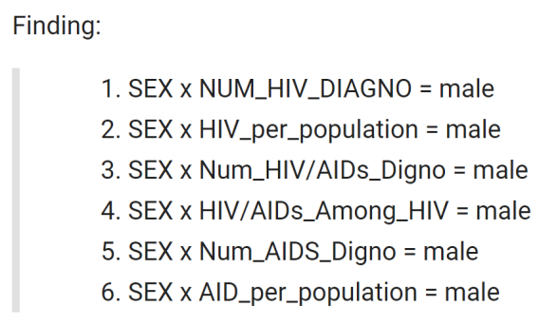

Slide 14
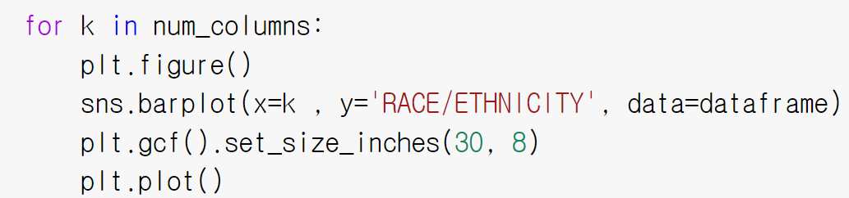
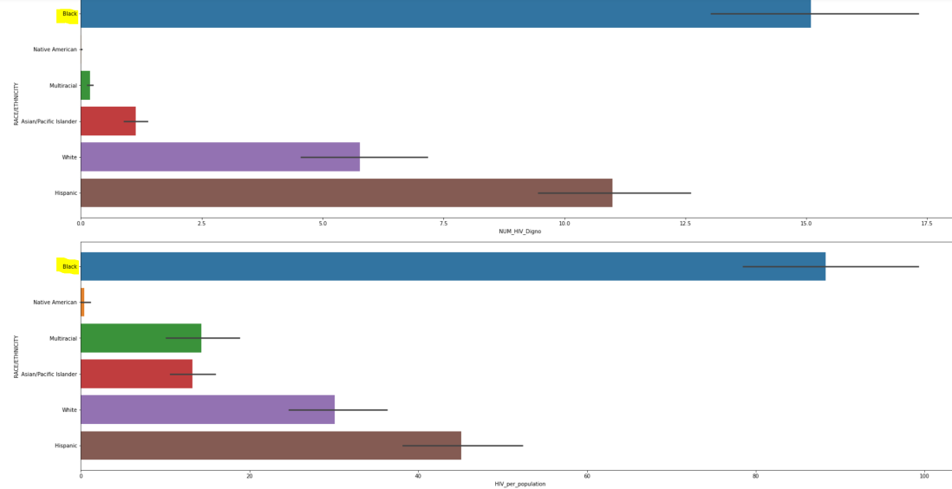
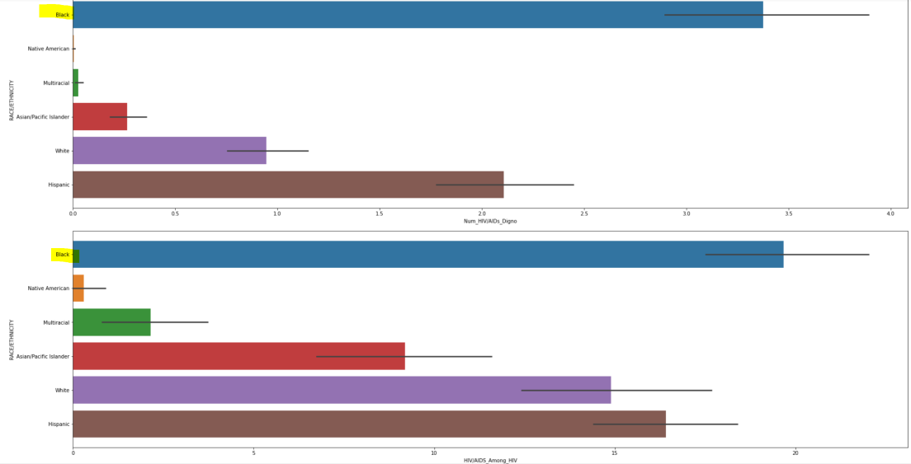
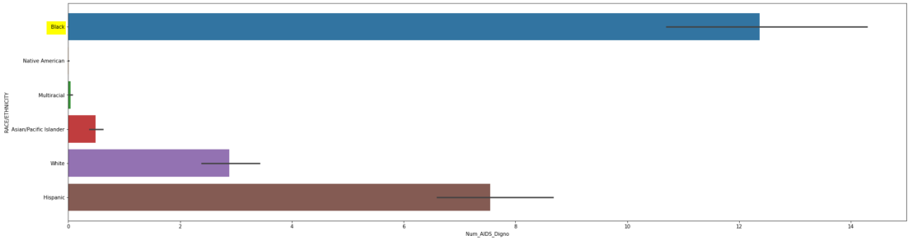
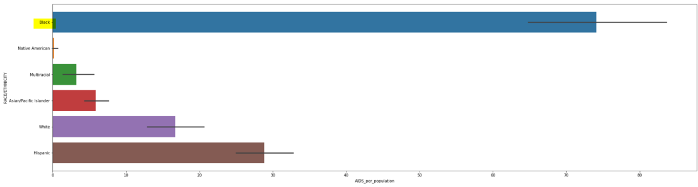
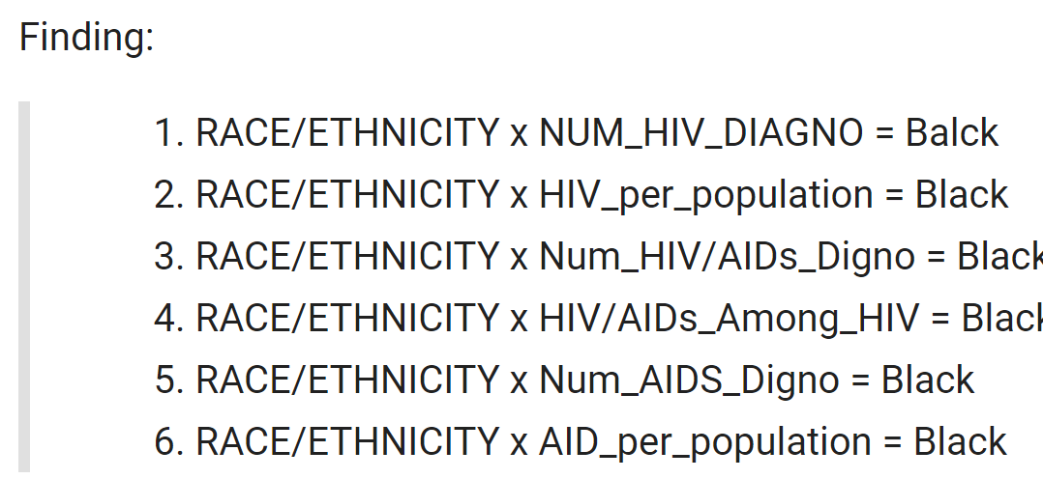
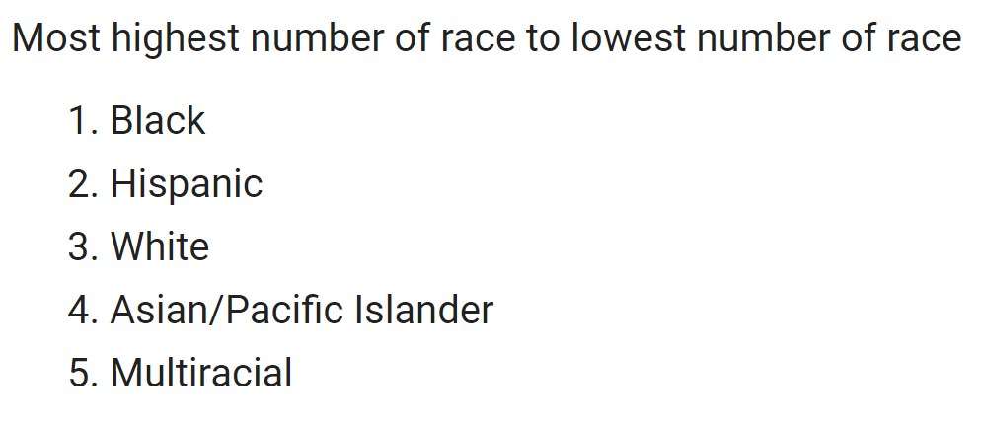

Slide 15
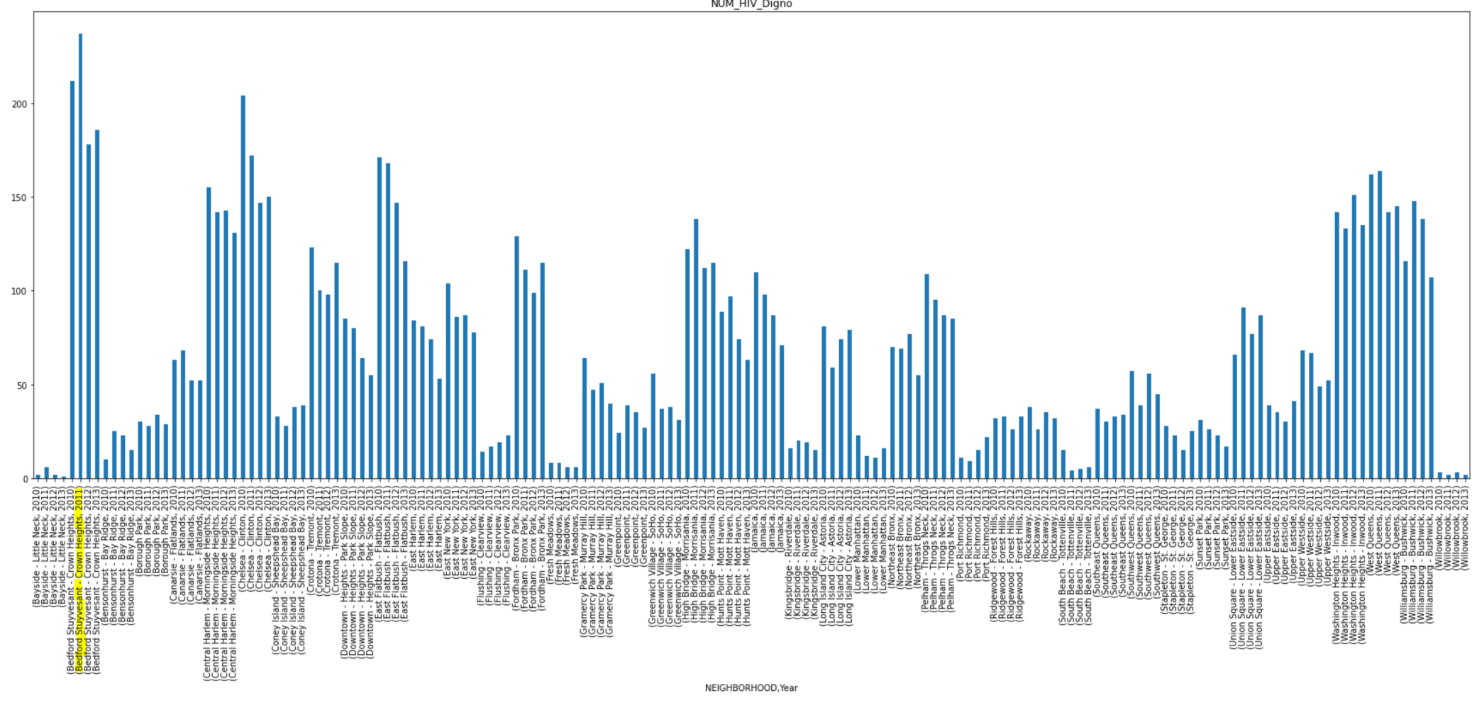
NEIGHBORHOOD, Year X NUM_HIV_Digno

Slide 16
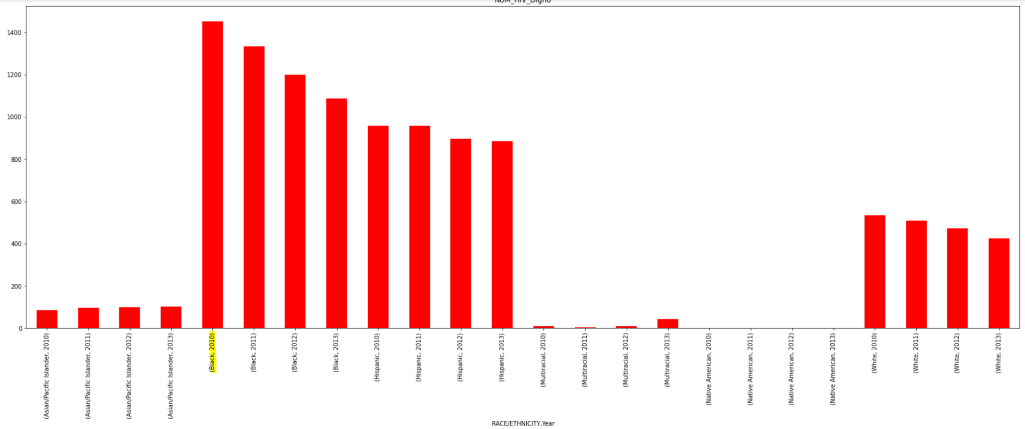
RACE/ETHNICITY, Year x NUM_HIV_Digno

Slide 17
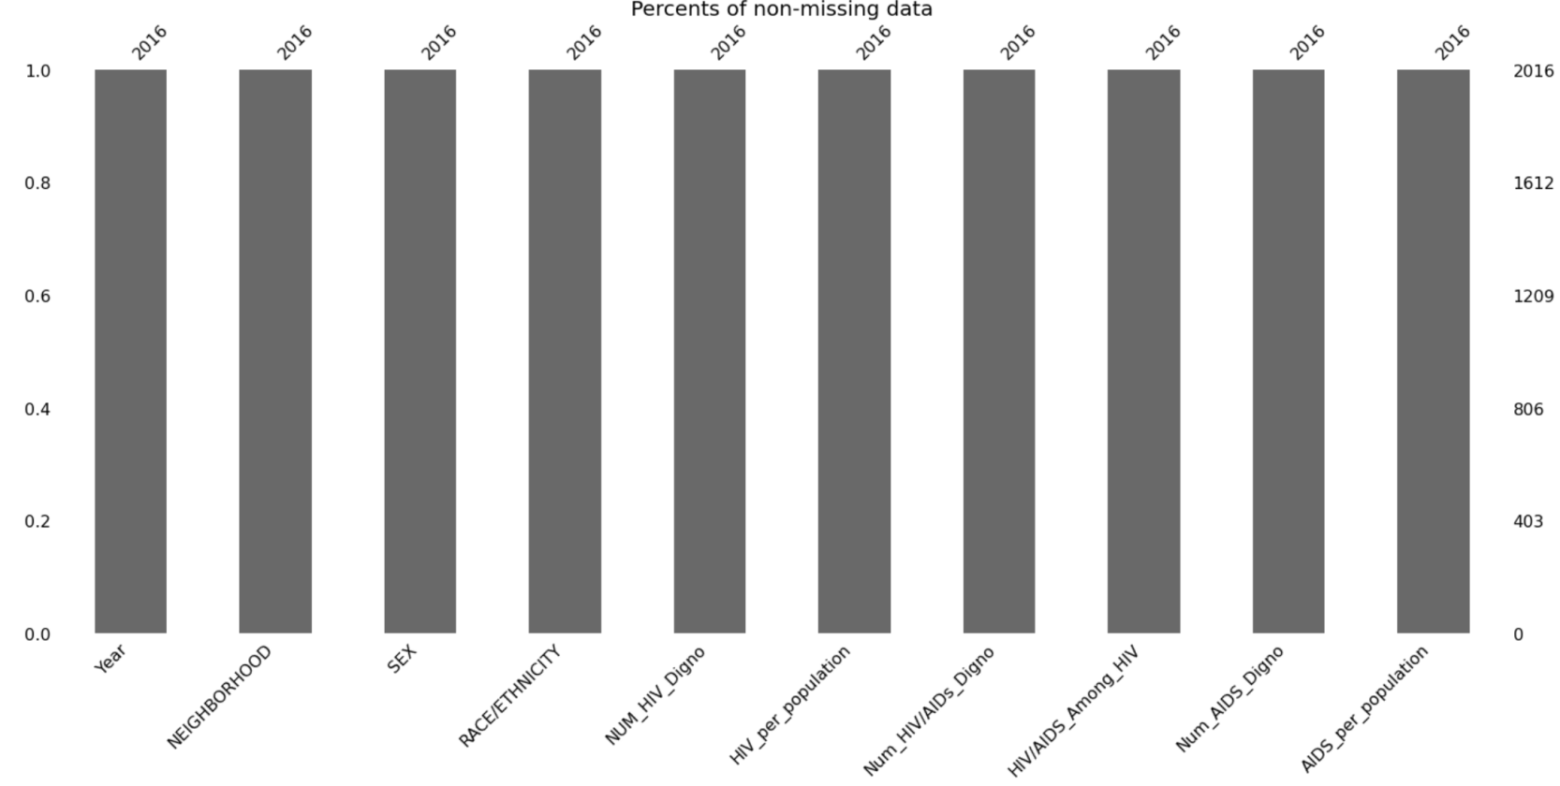
Feature Engineering
Handling missing data
As it could be seen there are no missing data , meaning NA

Slide 18
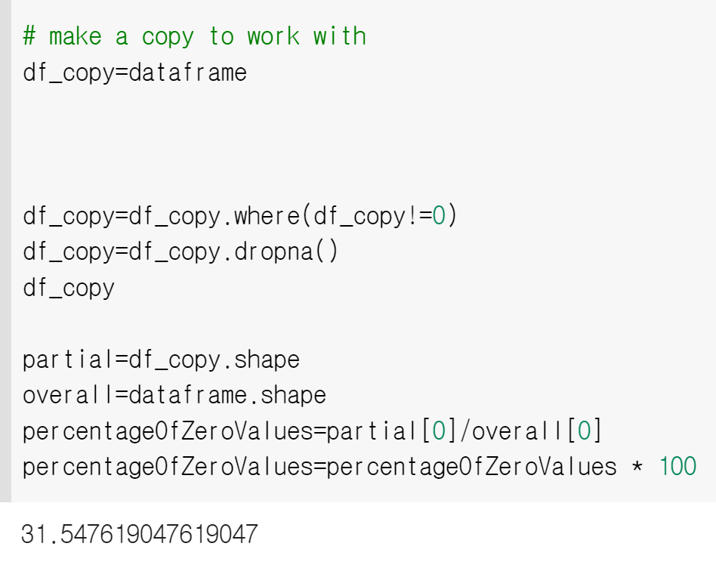
Dropping all zero values
31% of data are either zeros or Unkown since we dropped all the NA values in EDA work

Slide 19
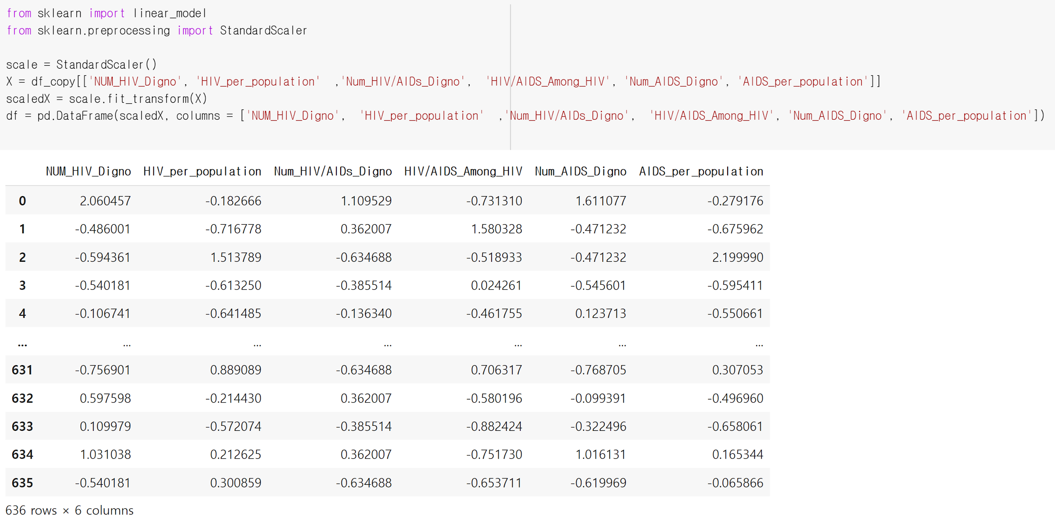
Scaling the data

Slide 20
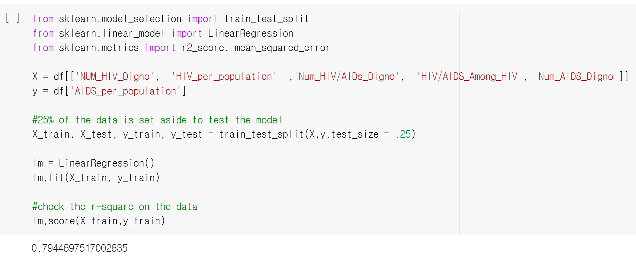
Linear Regression

Slide 21
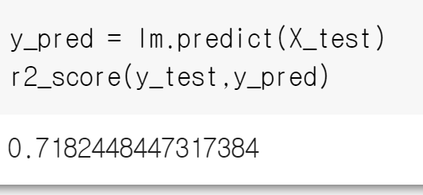
Model1 -Prediction

Slide 22
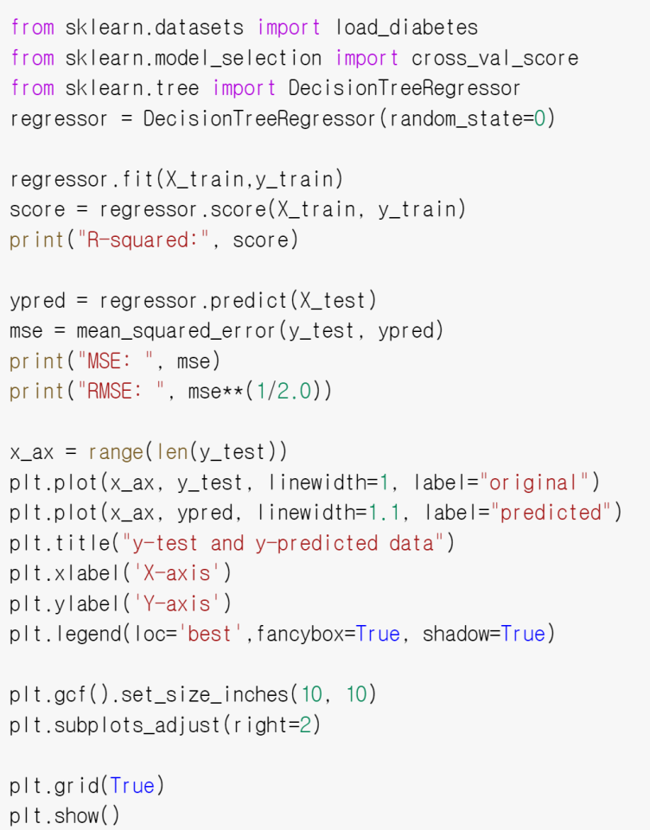


Model2-Decision Tree Regression
MSE: A metric that tells us the average squared difference between the predicted values and the actual values in a dataset. The lower the MSE, the better a model fits a dataset.
RMSE: A metric that tells us the square root of the average squared difference between the predicted values and the actual values in a dataset. The lower the RMSE, the better a model fits a dataset.

Slide 23


Model3-RandomForestRegressor
Model4-XGBoost Regressor

Slide 24


Stacking ensemble of models
We will evaluate the following five algorithms:
Logistic Regression. K-Nearest Neighbors. Decision Tree. Support Vector Machine.
And Naive Bayes.
compare ensemble to each standalone models for regression

Slide 25




Stacking for Regression
compare ensemble to each standalone models for regression

Slide 26
Conclusion
To conclude , when we compare male vs female, male are on higher risk to be expose to HIV. Also, our finding shows black and hispanic men are in the greatest risk to be expose to HIV.
In regard of modeling of the data,we used XGBoost Regressor,RandomForestRegressor,Linear Regression,Tree Regressor to model the dataset. By comparing the accuracy of the 4 generated models, we can say that linear regression and tree regression are more accurate of all models we generated. Our preferred model would be linear regression with accuracy of 83%.

